Slide 1
NC Narrative Project
Handbook Training

Slide 2
We Set Out To…
Understand the core values, attitudes and motivations of North Carolina’s current and potential voters.
Develop effective language and a messaging framework to help progressives do a better job at winning.
Construct strategies to neutralize racial dog-whistling, anti-democratic, nativist, and toxic messaging from the Right.
Produce messaging recs for new voters, potential voters, voters in differing regions and communities of color.

Slide 3
Via…
60
ONLINE JOURNAL PARTICIPANTS
36
ON-THE-STREET INTERVIEWS
21
FOCUS GROUP
PARTICIPANTS
2
STATEWIDE POLLS
Our recommendations are derived from research with North Carolinians from every major demographic group and geographic area.

Slide 4
With Help From…

Slide 5
What Voters are Telling Us
In Their Own Words

Slide 6
Voters are disappointed their lives haven’t improved under a Democratic president
[Democrats are] maintaining the status quo...flying under the radar, not making any real changes...a good way to collect votes I guess."
For the most part little has changed at all, and nothing has directly changed to impact my life."
As of right now, the [election] outcome has made no difference to my husband or myself. So far, for NC – I don't think [things] have changed much."
Things haven’t gotten better, I thought they would. Rethinking [stance on Democrats]."

Slide 7
But Also See Republicans as a Problem
I remember when you could talk to Republicans and now they’re being radicalized and becoming fanatical"
[Republicans are] just out for themselves. Want it their way. So polarized. Not open to hearing all sides."
The current Republican Party represents old, racist, rich white men that are focused on oppressing people rather than being democratic"
I feel that the Republican Party is traditionally designed to keep the rich rich"

Slide 8
They Are Eager for a Better Government
I just want us to come back together and work for the better of the whole team and country and its people in a peaceful and unified way"
I want to see a government that supports and invests in our country's success and the success of its people"
I would like our government to help everyone get access to resources and opportunities to thrive. I wish our government was one which made everyone happy and worked for everyone"
I would like to see government working at the will of the average person, not the wealthy."

Slide 9
Messaging Guidance
Story of Us / Story of Them / Contrast

Slide 10
The Story of Us
What Democrats need to communicate

Slide 11
Quick Narrative
Democrats are…
Compassionate
Ethical
Experienced
Focused on what matters
They will…
Understand the issues at stake
Bring different groups together
Listen and respond
Deliver practical solutions

Slide 12
Quick Narrative
They advocate for…
A more prosperous state for all
A safer, healthier future
The freedom to thrive
Responsive, not restrictive, gov’t
They stand up against…
Racists and white supremacists
Radicals and extremists
Greedy corporations
Corruption and cronyism

Slide 13
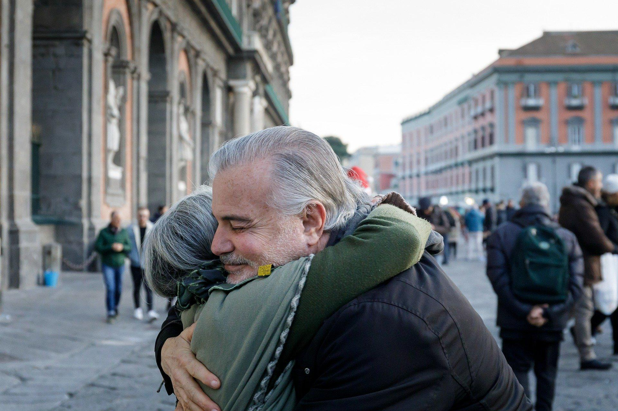
Associate Democrats with…
Fighting for the future
Working for the people
Delivering solutions
Working together
Unity

Slide 14
Putting it in Practice: Example 1
As the former Chief Justice of the North Carolina Supreme Court, Cheri Beasley has years of experience listening to both sides of an issue and understanding what's at stake. In the U.S. Senate, she will continue to be a compassionate and ethical leader as she works to create a safer, healthier future for all.

Slide 15
Putting it in Practice: Example 2
Instead of engaging in petty partisan squabbles, Cheri Beasley is focused on what matters: creating a more prosperous North Carolina for all. She will work to lower the skyrocketing cost of living, and expand access to healthcare and education, so more people have the freedom to thrive, not just survive.

Slide 16
The Story of Them
What we need to communicate about Republicans

Slide 17
Quick Narrative
Republican politicians are…
Out-of-touch
Self-centered
Slow to change
Power-hungry
They will…
Take us backwards
Prioritize profits over people
Cave to lobbyists, the top one percent, and greedy corporations
Hurt average North Carolinians

Slide 18
Quick Narrative
They encourage…
Chaos
Division
Dysfunction
A weakened democracy
They don’t stop allies who engage in…
Racism and discrimination
Corruption
Violent extremism
Dangerous misinformation

Slide 19
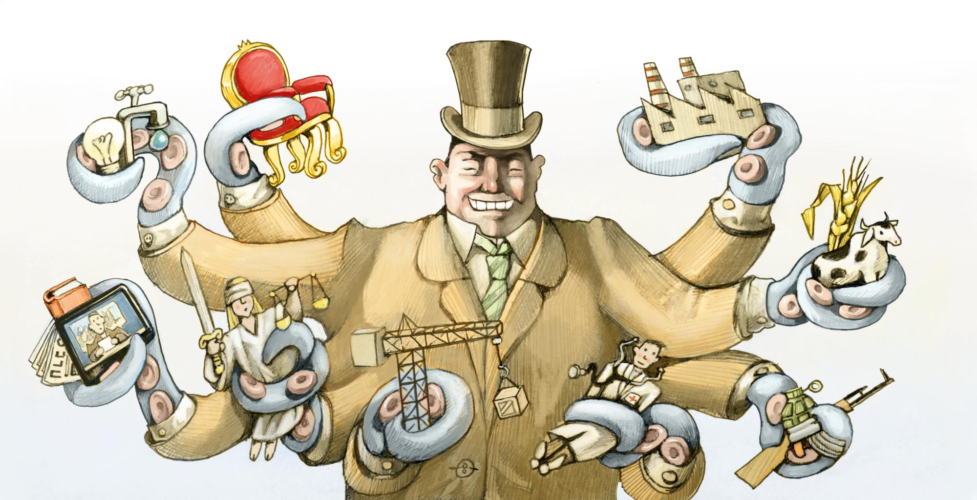
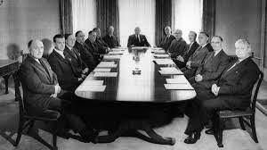
Associate Republicans with…
Chaos
Division
Dysfunction
Corruption
Taking us backwards

Slide 20
Putting it in Practice: Example 1
Ted Budd is more focused on what lobbyists and corporate donors want than what average North Carolinians need. With the cost of gas and other essentials skyrocketing, Budd voted against legislation that would hold big oil companies accountable for price gouging and lower costs for North Carolinians. We can’t afford more leaders who prioritize profits over people.

Slide 21
Putting it in Practice: Example 2
Ted Budd is part of a group of Republican politicians who repeatedly block common sense gun safety legislation from passing. Budd, a gun store owner, opposes any expansion of background checks for gun sales and even sent a letter to the Governor trying to get him to reject federal gun safety regulations. We don't need more radical politicians contributing to the dysfunction and gridlock in Washington.

Slide 22
The Contrast
How to convey the differences between Democrats and Republicans

Slide 23
Republican Traps
Government overreach / Freedom – Republicans will capitalize on voters’ value for freedom and fear of government overreach to argue against any action to increase regulations, from protecting the environment to reducing gun violence. Similarly, they will take up the mantle of parental rights when it comes to education, LGBTQ rights, and other issues.
Cynicism / Dysfunction – Republicans know that voters have a disdain for politicians of all stripes, and they will use this to hammer home the idea that government cannot be trusted and must thus be diminished. The more cynical voters are about government efficacy (whether it is schools or the CDC), the better it is for Republicans.

Slide 24
Republican Traps
Personal responsibility / Handouts – Americans strongly believe in their own agency and autonomy, and consistently lift up the values of hard work and responsibility. Republicans capitalize on this by insinuating that those who struggle are not working hard enough, and label efforts to help them as handouts that will further encourage laziness.
Scarcity – Republicans often make the world seem like a zero-sum game, where in order for someone to have more, someone necessarily has to have less, whether it is the economy or healthcare. They highlight feelings of scarcity in the world (like the current supply chain shortages) and make them seem natural, as opposed to driven by corporate greed and other bad actors.

Slide 25
Republican Traps
Race-baiting / Culture Wars – Republicans will use ugly tactics to prey on voters', and especially white voters', fears and disillusion. They will gin-up controversy on social issues to distract from their inaction on reforms.
Denialism – When they are not magnifying issues that occur relatively infrequently, like voter fraud, Republicans will minimize issues that are of critical importance, whether it is denying the realities of climate change or refusing to accept the results of the 2020 election.

Slide 26
Reframing the Issues in Progressive Terms
Freedom to Thrive – Every North Carolinian deserves the freedom to spend time with their loved ones, to enjoy the fruits of their labor, and to live free of the fear of rising medical costs. Democrats will work to extend these freedoms and create more high quality, well paying jobs so that everyone who works hard and plays by the rules can achieve their own version of the American Dream.
Pragmatism – Democrats know the last few years have been hard with the pandemic, rising cost of living, and increasing division at home and abroad. But we also know that when Americans come together, we can accomplish a lot. We are ready to get to work fighting inflation, creating good-paying jobs, and ensuring working people have the tools to build a better life.

Slide 27
Reframing the Issues in Progressive Terms
For the Future – Democrats are fighting for the people and for the future, whether it's expanding Medicaid so more people can live healthier lives, fully funding our public schools so our children can thrive, or providing better infrastructure like roads and broadband. Investing now means a safer, healthier, brighter future for all.
Shared Prosperity – It’s been a tough few years, but hardworking Americans are bringing us back from the pandemic. We are all better off when the whole country is prospering, that’s why Democrats are working to get things done for North Carolinians by rebuilding the middle class and lowering the costs of basic needs.

Slide 28
Reframing the Issues in Progressive Terms
Unity – Our country is strongest when we all work together and get ahead together. Instead of injecting partisan politics into areas like schools, and further dividing our communities on racial and political lines, we need to come together - Black, white, Brown, Indigenous - to build a strong and prosperous North Carolina for all.
Adults in the Room – Republican politicians, beholden to their corporate donors and lobbyists, continue to deny and delay on a host of actions from climate change to gun control. Some are still complaining about the 2020 election, instigating violence and chaos as they sow doubt on certified results. Democrats respect the rule of law, will ensure our elections remain free and fair, and are focused on what matters: securing a safe, healthy, and prosperous North Carolina for all.

Slide 29
Individual vs. Collective
Republicans want you to believe…
At the end of the day, everyone should only look out for themselves, because it is the best way to get ahead.
Democrats know…
As American citizens, we have a responsibility to our family and our communities. Since our fates are intertwined, we should all work together and get ahead together.

Slide 30
Nostalgia vs. Progress
Republicans want you to believe…
America is the greatest country in the world. We need to stop trying to change it for the worse, and instead return America to the greatness we experienced in the 20th century.
Democrats know…
America is a great country, not because we have always lived up to the principles stated in our foundation, but because we have never stopped trying to be better. It is our duty as Americans to come together and build a stronger future.

Slide 31
Narrative Summary
DEMOCRATS are…
REPUBLICANS are…
Fighting for the future
Building coalitions
The adults in the room
Pragmatic & Responsive
For the people
Working together
Bringing us backwards
Furthering division
Causing chaos
Radical & Slow to Change
For the top one percent
Working to stay in power

Slide 32
Conclusion

Slide 33
Key Takeaways
Show that Democrats are compassionate and understand what matters. They listen and respond, and work together with the people for practical solutions. They are allies, and won't get in the way.
Show that Republicans are out-of-touch and self-centered. They will prioritize profits and their donors over average North Carolinians. Their radicalism and corruption will take us backwards and further divide us.
Offer voters a vision of the future: one where we are united across race, where we work together to get ahead together, where everyone has the freedom to reach their full potential.
Emphasize the power of collective action. We are not only fighting against the evils of greed, corruption, and racism, but also the sometimes debilitating effects of apathy and helplessness.

